Slide 1

Fetch Types: Eager vs Lazy

Slide 2




Fetch Types: Eager vs Lazy Loading
When we fetch / retrieve data, should we retrieve EVERYTHING?
Eager will retrieve everything
Lazy will retrieve on request
Course
Course
Instructor
Course
Course
www.luv2code.com

Slide 3




Eager Loading
•
Eager loading will load all dependent entities
•
Load instructor and all of their courses at once
Course
Course
Instructor
Course
Course
www.luv2code.com

Slide 4
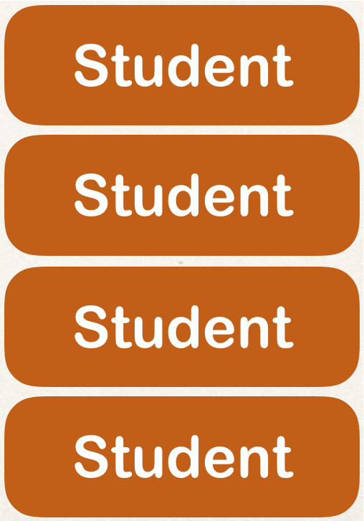




Eager Loading
What about course and students?
Could easily turn into a performance nightmare …
Course
www.luv2code.com

Slide 5
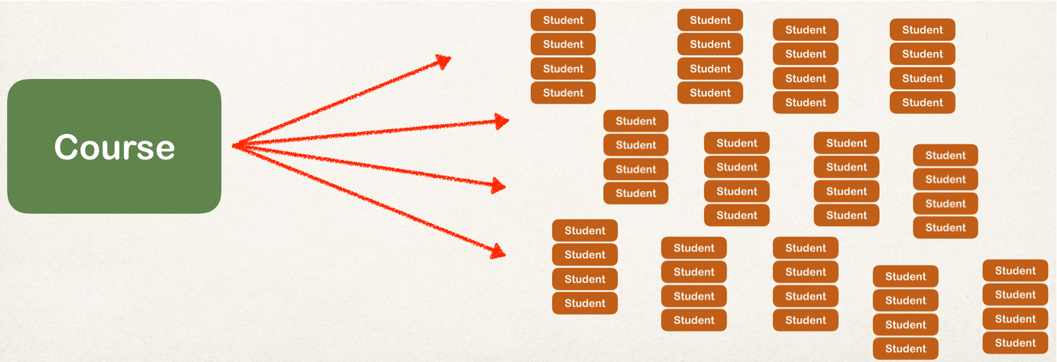
Eager Loading
In our app, if we are searching for a course by keyword
Only want a list of matching courses
•
Eager loading would still load all students for each course …. not good!
www.luv2code.com

Slide 6


Best Practice
Only load data when absolutely needed
Prefer Lazy loading instead of
Eager loading
www.luv2code.com

Slide 7

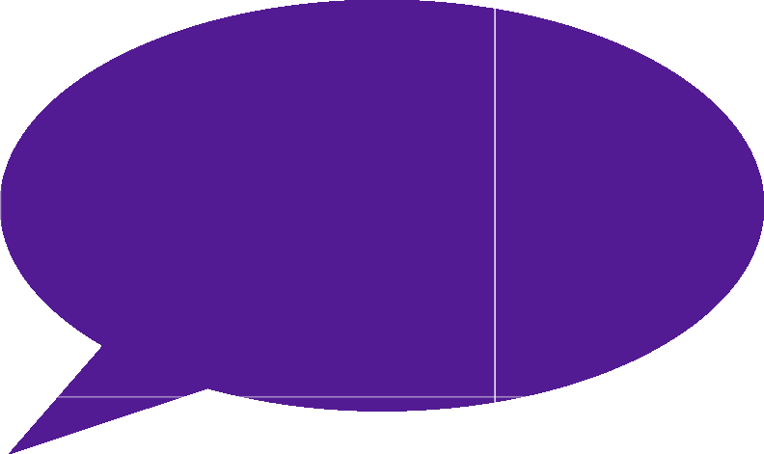

Lazy Loading
Lazy Loading is preferred
Lazy loading will load the main entity first
Load dependent entities on demand (lazy)
Load on demand (lazy)
Load course first
www.luv2code.com

Slide 8

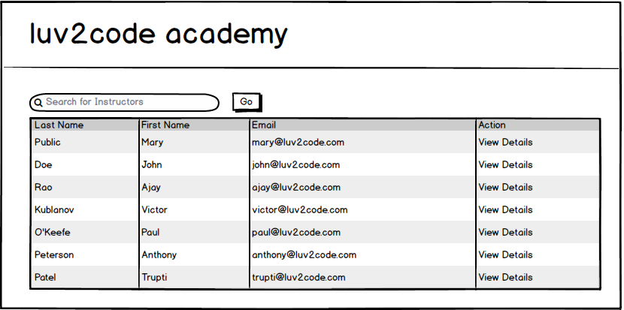
Real-World Use Case
Search for instructors
www.luv2code.com

Slide 9
Real-World Use Case
•
In Master view, use lazy loading
•
In Detail view, retrieve the entity and necessary dependent entities
www.luv2code.com

Slide 10

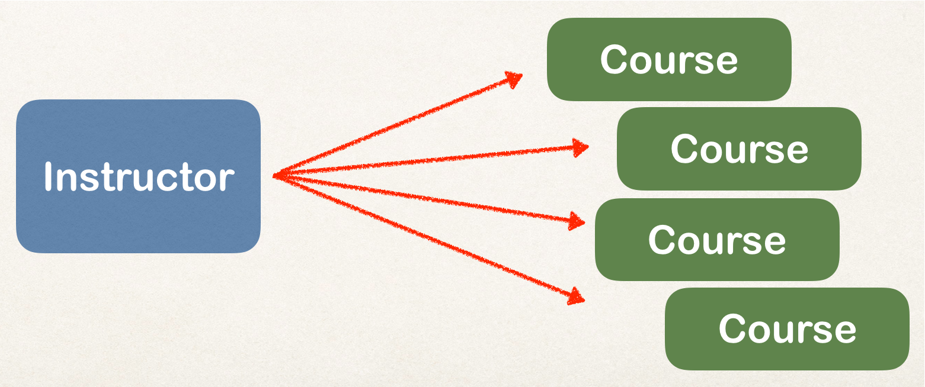

Real-World Use Case - Master View
In Master view, use lazy loading for search results
Only load instructors … not their courses
www.luv2code.com

Slide 11

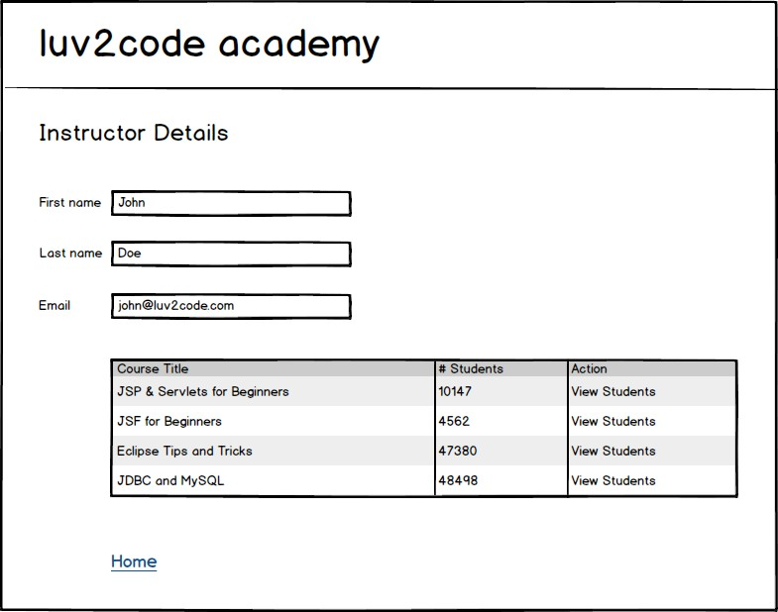

Real-World Use Case - Detail View
In Detail view, retrieve the entity and necessary dependent entities
Load instructor AND their courses
List of courses
www.luv2code.com

Slide 12


Fetch Type
When you define the mapping relationship
You can specify the fetch type: EAGER or LAZY
@Entity @Table(name="instructor") public class Instructor {
…
@OneToMany(fetch=FetchType.LAZY, mappedBy=“instructor”) private List<Course> courses;
…
}
www.luv2code.com

Slide 13
Default Fetch Types
Mapping | Default Fetch Type
@OneToOne | FetchType.EAGER
@OneToMany | FetchType.LAZY
@ManyToOne | FetchType.EAGER
@ManyToMany | FetchType.LAZY
www.luv2code.com

Slide 14
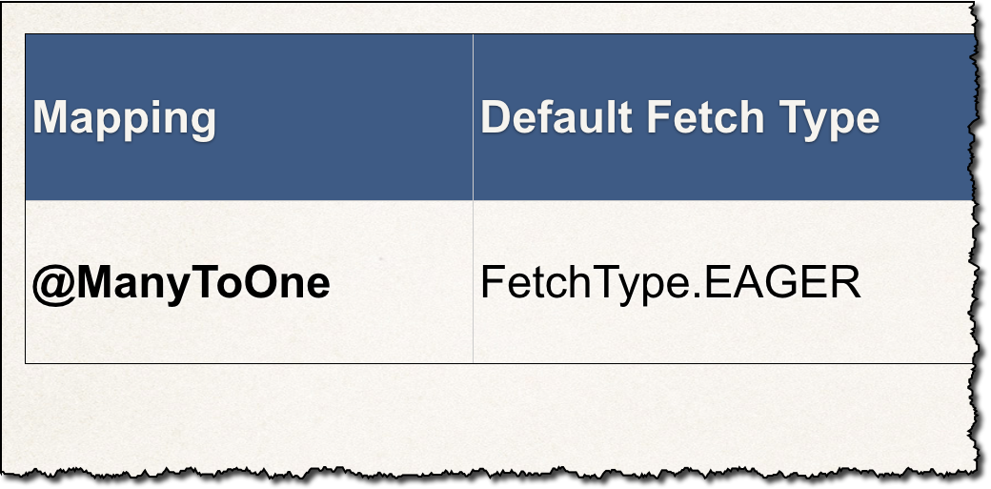

Overriding Default Fetch Type
Specifying the fetch type, overrides the defaults
@ManyToOne(fetch=FetchType.LAZY) @JoinColumn(name="instructor_id") private Instructor instructor;
www.luv2code.com

Slide 15
More about Lazy Loading
•
When you lazy load, the data is only retrieved on demand
•
However, this requires an open Hibernate session
need an connection to database to retrieve data
www.luv2code.com

Slide 16

More about Lazy Loading
•
If the Hibernate session is closed
•
And you attempt to retrieve lazy data
•
Hibernate will throw an exception
Watch out for this!
www.luv2code.com

Slide 17
More about Lazy Loading
To retrieve lazy data, you will need to open a Hibernate session
•
Retrieve lazy data using
•
Option 1: session.get and call appropriate getter method(s)
•
Option 2: Hibernate query with HQL
•
Many other techniques available but the two above are most common
www.luv2code.com

